Slide 1

Darshan University
Presented by:- Bhoomi Tulsiyani
Enrolment No:- 23010101275
Branch:- B.Tech CSE
Semester:- 3rd

Slide 2
ABOUT
A prominent organization offering a broad slate of academic programs and professional courses for undergraduate, graduate and postgraduate programs in Engineering, Science & Technology
Located in peaceful surroundings with distinctive collegiate structure, about 19 km from Rajkot, Gujarat, India
Established as an Engineering Institute in the year 2009, by Shree G. N. Patel Education & Charitable Trust with the objective to impart quality education and training in various fields of Engineering and Technology
Grown steadily and created a unique identity in the field of Engineering & Technology by implementing skill and training-based foundation for education

Slide 3

MOTTO
This verse advises us to perform our allocated duty excellently. Kaushalam signifies doing work with devotion and without attachment. Such detached attitude enhances its values and improves the concentration and skill of the worker. If we work with elegance, fortitude, and skill our Body-Mind-Soul will co-operate with our hands. Any work becomes valuable if carried out with full concentration, dedication, and abilities and also helps us to become valuable to others as well as to society.

Slide 4
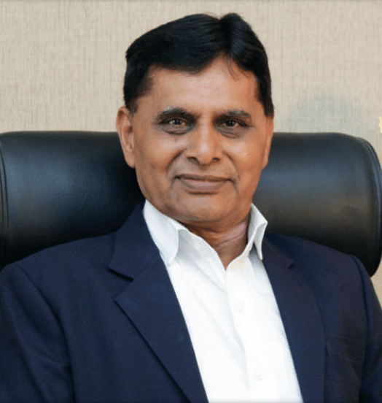
ADMINISTRATIVE LEADERSHIP
Dr. Ramnik G. Dhamsaniya
Dr. Ramnik G. Dhamsaniya, the vibrant and visionary President of Darshan University and prominently recognized as a pivotal pillar and an outstanding administrator in the field of education. Upon completing his Bachelor of Civil Engineering from Lukhdhirji Engineering College, Morbi, Master of Engineering in Structural Engineering & Ph.D. in Concrete Technology from Birla Vishvakarma Mahavidyalaya (BVM), Sardar Patel University.

Slide 5
Constitute Institute
Institute of Engineering and Technology
Institute of Engineering and Technology for Diploma Studies
Institute of Management
The primary emphasis of Darshan University is on innovation, flexibility, relevance, and cost-effectiveness in all its programmes. Academic programs at Darshan University are designed to enable growth and learning in a highly focused and application-based environment. This is achieved through a combination of formal lectures and hands-on experience in well-equipped laboratories and through project activity, which will equip students to design and operate high-end computing systems.
Darshan University is one of the premier organizations in Diploma Engineering Education in Rajkot, Gujarat. The Institute has an excellent infrastructure with well-equipped laboratories and Computer Centers in every department, a large spacious computerized library with a reading hall and seating capacity of 250, it also has a registered Alumni Association.
Darshan University, Darshan Institute of Management (DIM) started functioning in the academic year 2021 - 22, offering BBA/BBA(Honors), B Com/ B Com(Honors), MBA & Doctoral programs. The department is rich in terms of experienced faculty members, library resources, and IT infrastructure. DIM provides an excellent atmosphere for its UG and PG students to develop educationally, physically, emotionally and intellectually through a robust teaching-learning system.

Slide 6
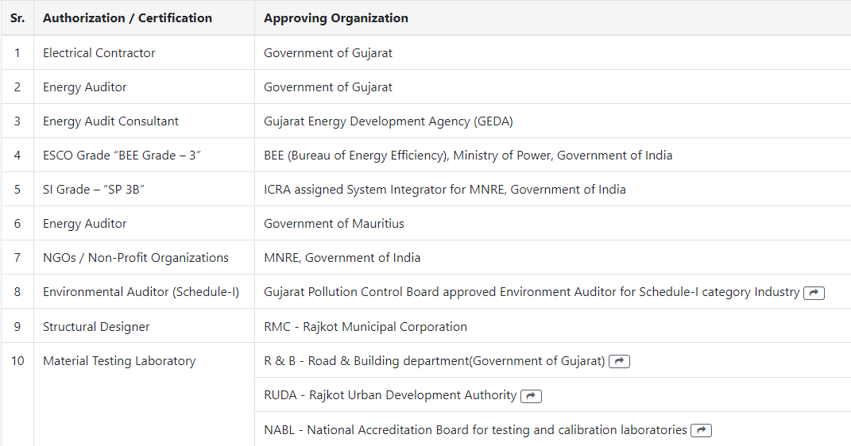
GOVERNMENT LICENSES

Slide 7

ABOUT ASWDC (SKILL DEVELOPMENT)
The department is proud to announce its "ASWDC - Apps, Software & Website Development Center". ASWDC is established by the Department of Computer Engineering, where students work on live projects under the guidance of faculty and industry experts. Students are getting extensive knowledge and industrial experience of cutting edge technologies.
ASWDC fills the gap between academic curriculum and industry expectations. The centre fulfils the software & website requirements of the Institute. Some of the developed programs are DLib – Darshan Library Management Software, etc. A team of faculty and students has developed iPhone, Android and Windows APPS for the library, Students details for parents (DParent) and Engineering Admission (ACPC).

Slide 8









TECHNOLOGIES WE WORK

